Slide 1
Stress Ball
Stress Detection android Application
Thomas Wolf

Slide 2
Requirements
What I did:
Investigate the reasons for stress and anxiety on college campuses.
Identify triggers or indicators that might be indicators of stress.
Perform an analysis of potential triggers that the app could detect and how it should react.
Interface the app with sensor data from Fitbit.
Still needs to be done:
Include usability tests with students in your analysis and design.
Determine how to measure the effectiveness of the app.

Slide 3
Objectives
What is stress? And how to detect it
Learn Android Studio
Learn some java
Learn oAtuh2
Get and use Fit Bit Data

Slide 4
Stress
A highly subjective phenomenon that is hard to define which in tern makes it hard to measure.
The term “stress”, as it is currently used was coined by Hans Selye in 1936, who defined it as “the non-specific response of the body to any demand for change”
In college top ten stressor: 1. Relationships 2. Managing Time 3. Finals and Mid-terms 4. Roommates 5. Finances 6. Family Needs 7. Lack of Resources 8. Difficulty Prioritizing 9. Illness
Someone who is at risk for high levels of stress may become more likely to develop various diseases from stomach ulcers, to heart attacks. Stress has very negative impact on the immune system.

Slide 5
Stress cont.
Some indicators include:
Anxiety, appetite changes, Fatigue, Lack of concentration, moodiness, sweaty palms, cold or flu etc.
Between 75% and 90% of visits made to the school health center are due to stress related issues.(American Institute of Stress)
Some Stress reducers include:
Exercise, yoga, good sleep, get a message, and deep breathing
Stress detection methods I am using will be sleep, heart rate, and steps taken using a fit bit.

Slide 7
Solutions (Java & Android)
Tim Buchalka Udemy
Professors
Some books
Youtube
Stack Overflow

Slide 8
Solution (oAuth2 magic)
First glance at it… run away
Maybe try android wearables? Gave myself 1 week to try
Ok back to oAuth2
This is the main driving force of my application
oAuth2 is used in most every application that requires a connection with social media page

Slide 9
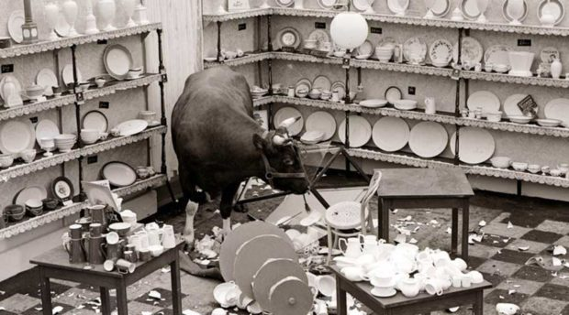

Slide 10
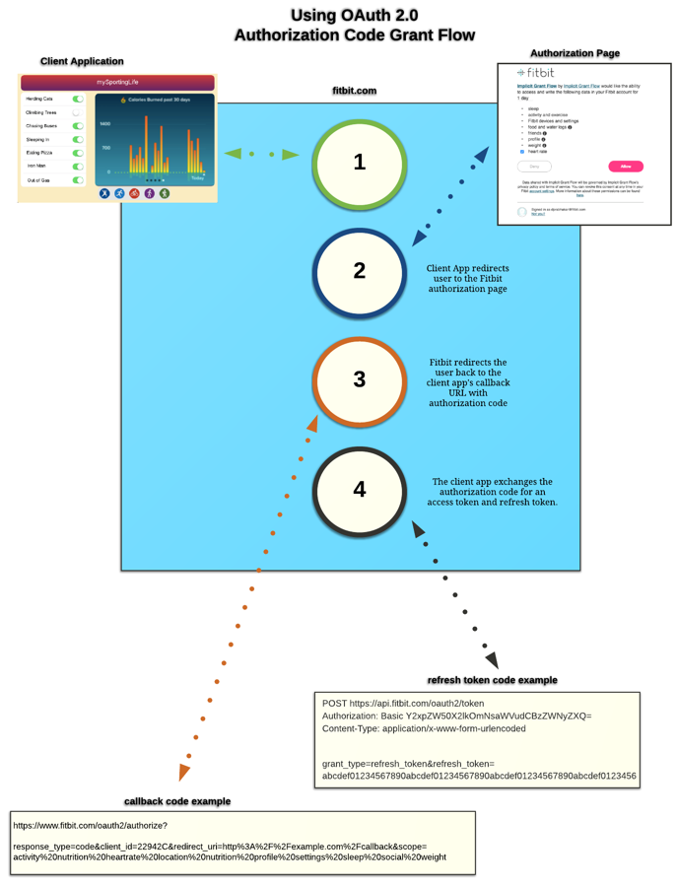
Solution (oAuth2 con’t)
Had a little chat with the previous creator →
Started to learn exactly how oAuth was working
4 steps using what Fit Bit calls Authorization code grant flow
Step 1: Your application redirects the user to Fitbit's authorization page
Step 2: Upon user consent, Fitbit redirects the user back to your application's redirect URL with an authorization code as a URL parameter.
Step 3: Your application exchanges the authorization code for an access token and refresh token.
Step 4: Your application stores the access token and refresh token. It will use the access token to make requests to the Fitbit API. It will use the refresh token to obtain a new access token when the access token expires without having to re-prompt the user.

Slide 11
Also user has a secret key consisting of 32 numbers or letters as well as a client id generated from fit bit
$client->redirect_uri = 'http://'.$_SERVER['HTTP_HOST']. dirname(strtok($_SERVER['REQUEST_URI'],'?')).'/index.php'

Slide 12
Good to go?

Slide 13
Data what to do with it?
02Data
No heart rate…better have a talk with fit bit
Find the json
Parse the json

Slide 14
DEMONSTRATION

Slide 15
What I want to still accomplish
Get oAuth to work without having to hit the server.
Make app contact fit bit without use of Google Chrome
Settings page for app
Clean up journal/bug check it some more
Test the app with other students
Determine effectiveness of current settings

Slide 16
What’s Next
Possibly move away from fit bit and oauth to use android wearables as students will now have a java/android class with 350
Get the app to work locally without the need of the comp sci servers. Implicit grant flow.
Start getting some test cases with other students.

Slide 17
Most Helpful
350 Event programming
220 Advanced Data and File Structures
322 programming languages
Good to know:
HTML,PHP,JAVASCRIPT, CSS
C#
Reading/Writing to file on server
Threads
Arrays

Slide 18
Future Advice
Do not be afraid to just jump and break things along the way. Save often and experiment
Use the debugger! (step in, step out, step on with life)
Don’t wait to start
Don’t just copy and paste what you find learn how it works so when you do break something you should have an idea what went wrong.
Make small simple programs than implement into your project
One function a day keeps the stress away

